Slide 1
Mandelbox Math
Dk why I made this into a presentation lmao

Slide 2
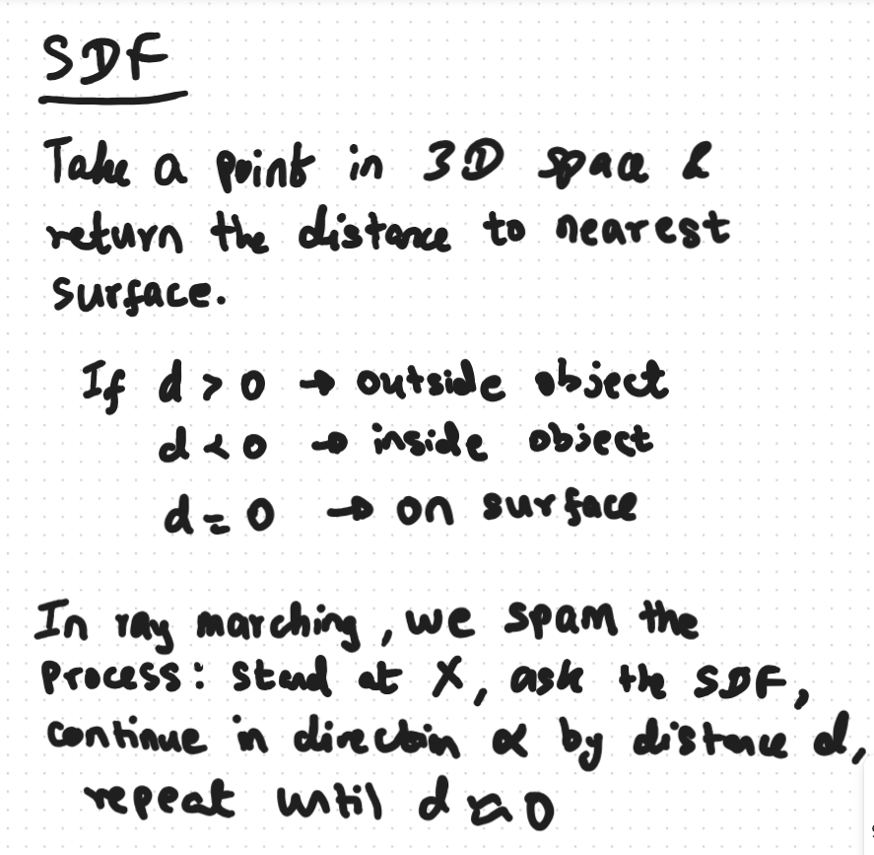
Example:
So like, let`s say we are looking through a pixel Y and there is a box point 10 metres ahead. There is also a box point 3 metres to the left. The distance function would say: 3 metres because that is the nearest surface in any direction. So, we would jump 3 metres in our predetermined direction and then ask again till we hit something or accept the miss after N iterations or sumn.

Slide 3
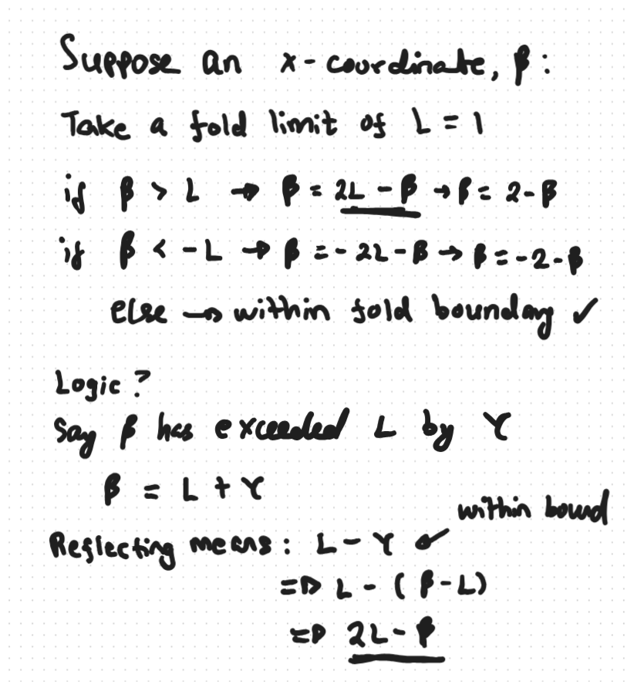
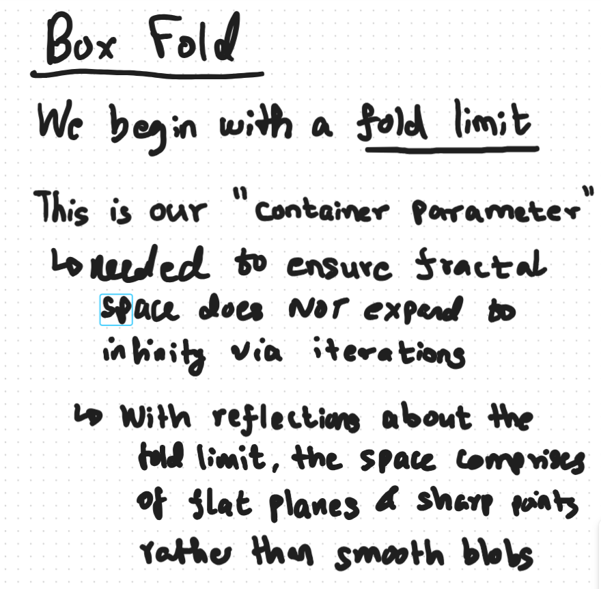

Slide 4
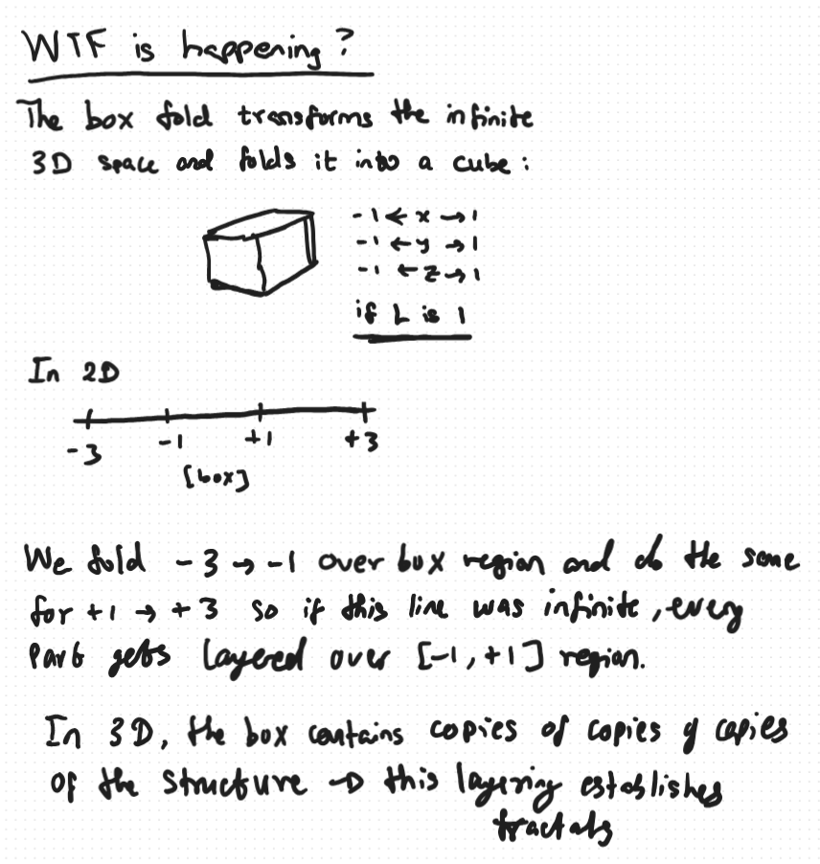
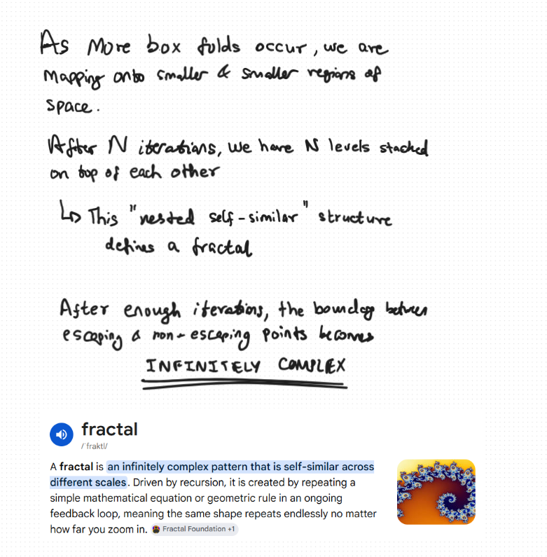

Slide 5


Example
p = (1.7, -1.3, 0.5)
x: 1.7 > 1 → x = 2 - 1.7 = 0.3
y: -1.3 < -1 → y = -2 - (-1.3) = -2 + 1.3 = -0.7
z: in range → z = 0.5
after box fold: p = (0.3, -0.7, 0.5)

Slide 6
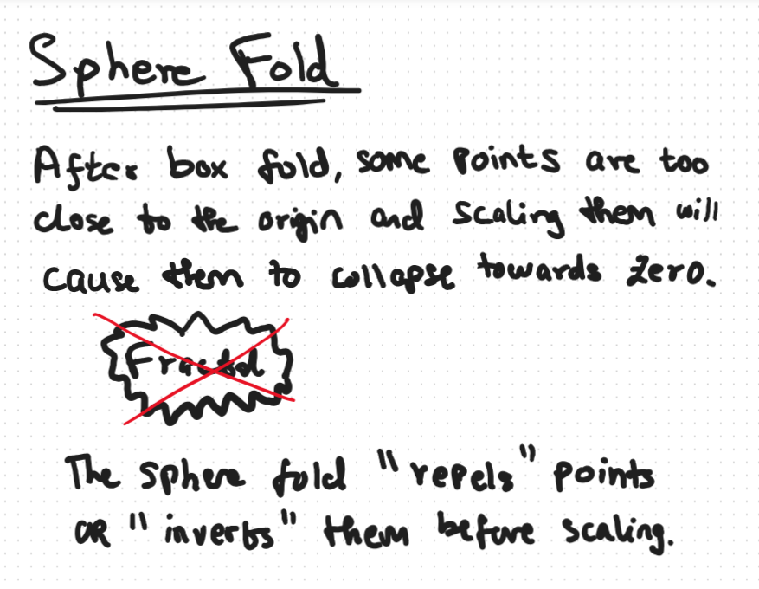
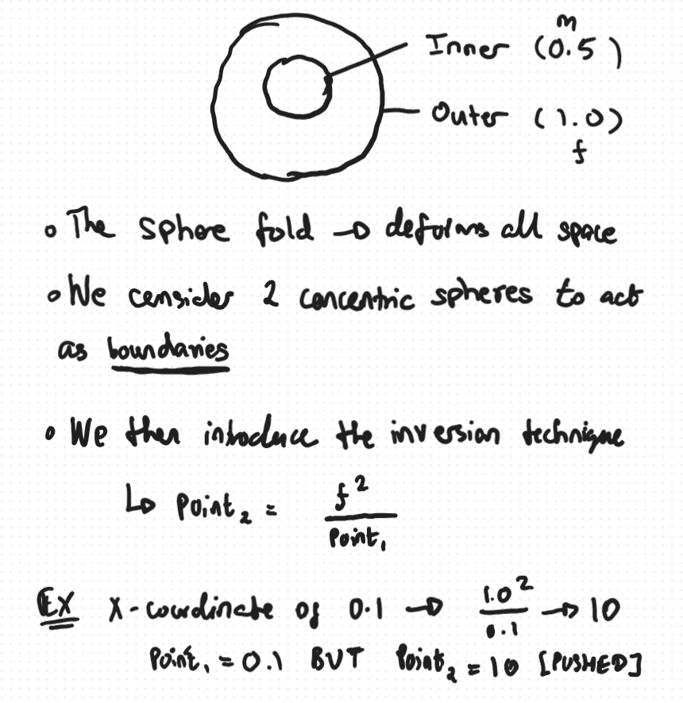

Slide 7
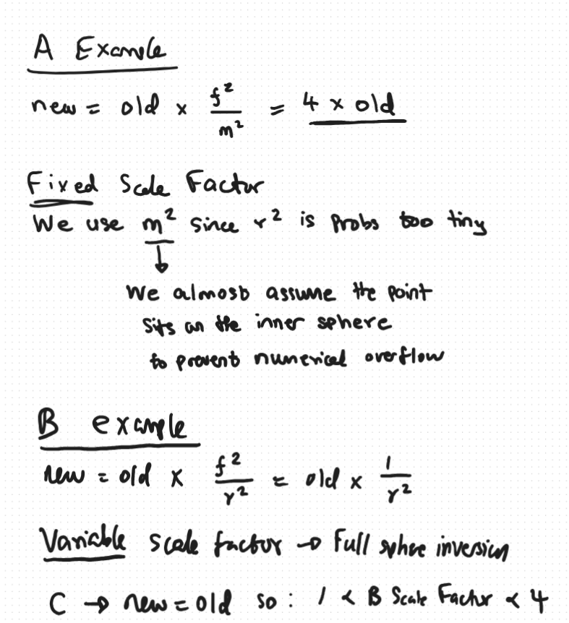
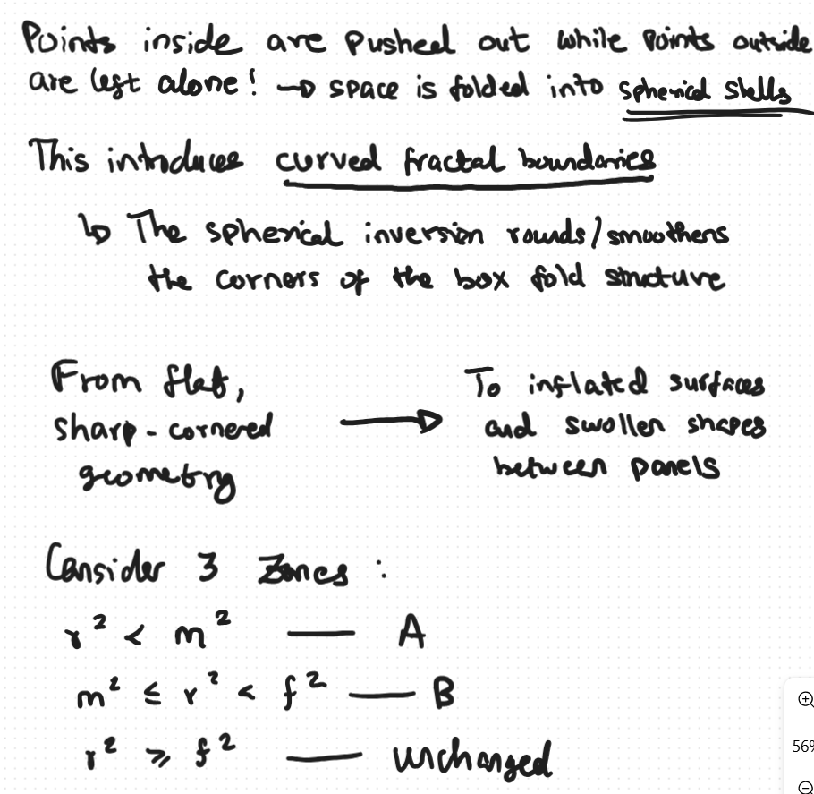

Slide 8
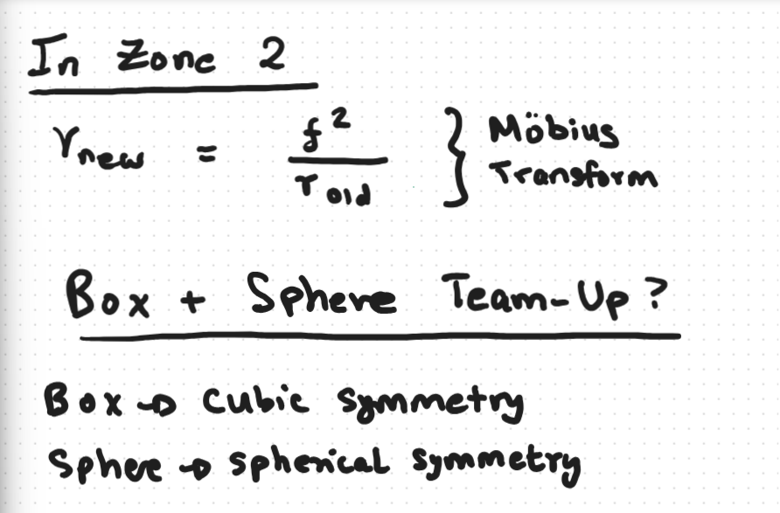
Together they produce a structure with both cubic large-scale symmetry AND spherical fine-scale curvature. This is what gives the Mandelbox its distinctive appearance — it looks like a cubic arrangement of rounded, organic shapes.
The key interaction: with l = 1.0 and f = 1.0, the sphere fold boundary at r = 1.0 matches the box fold boundary. Points at the corners of the box (distance sqrt(3) ≈ 1.73 from origin) are outside the sphere — they pass through Zone 3 unchanged.
Points closer to the faces of the box (distance ≈ 1.0) are right on the sphere boundary. This creates the smooth rounded appearance at the corners and edges of the Mandelbox.

Slide 9
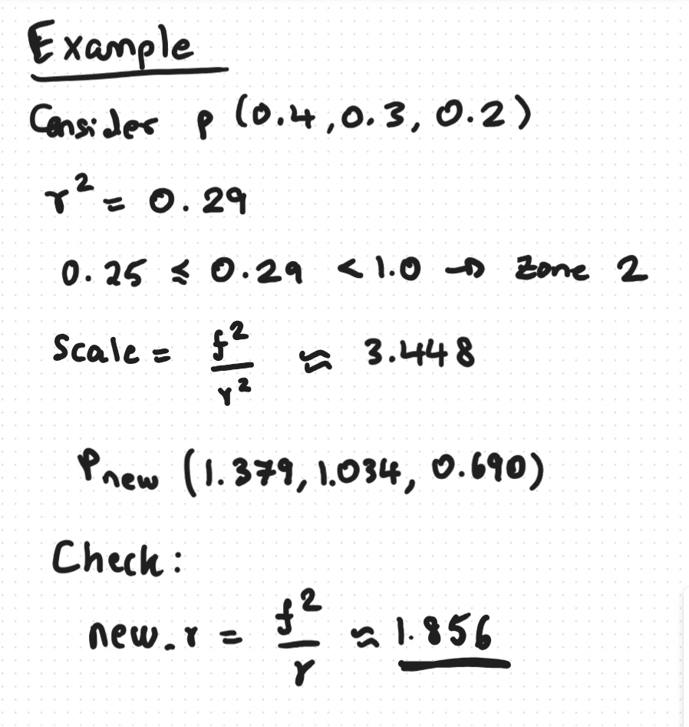

Slide 10
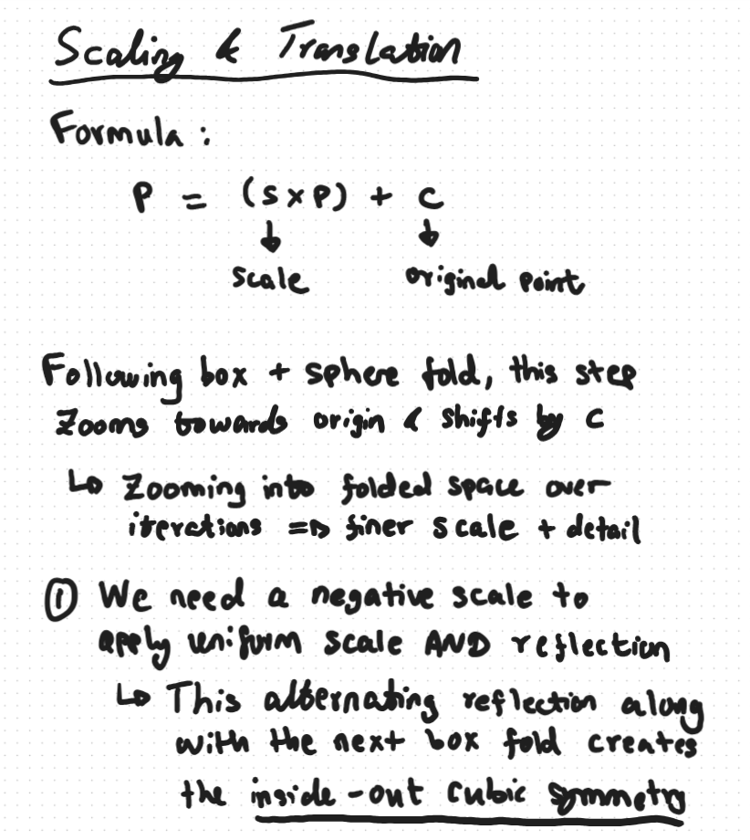
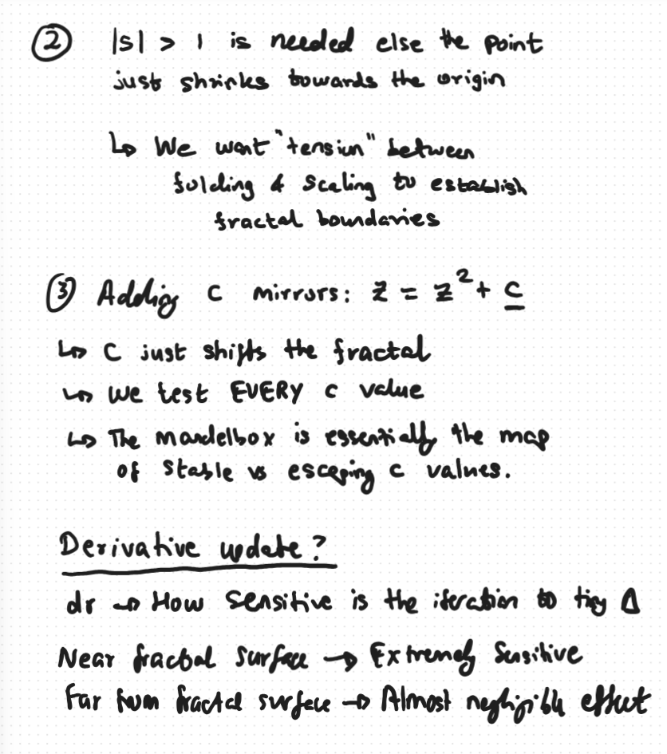

Slide 11
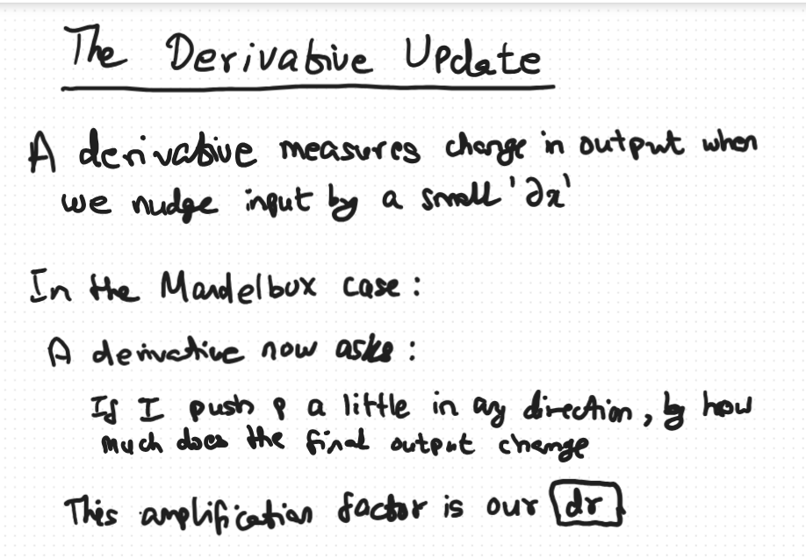

Slide 12
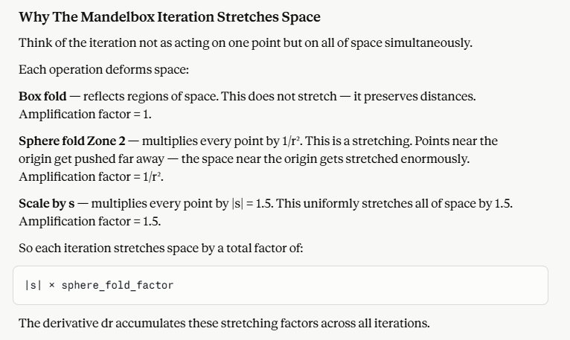

Slide 13
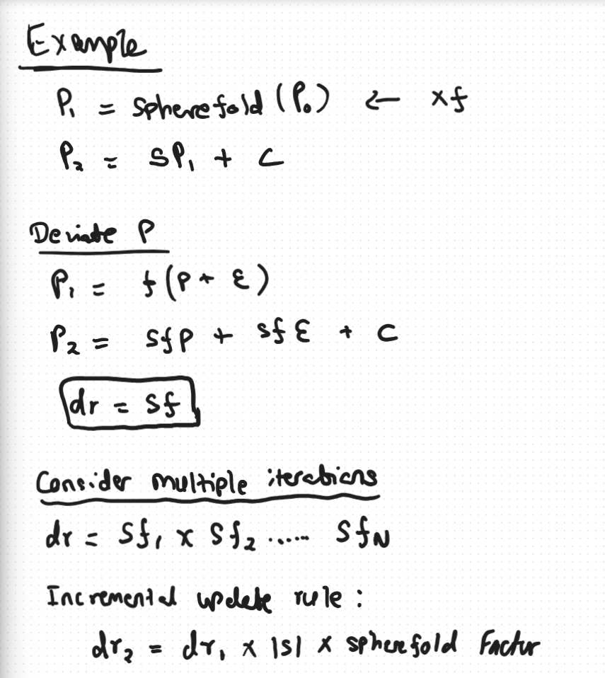
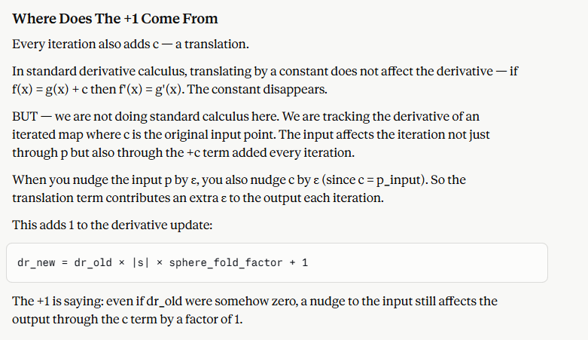

Slide 14
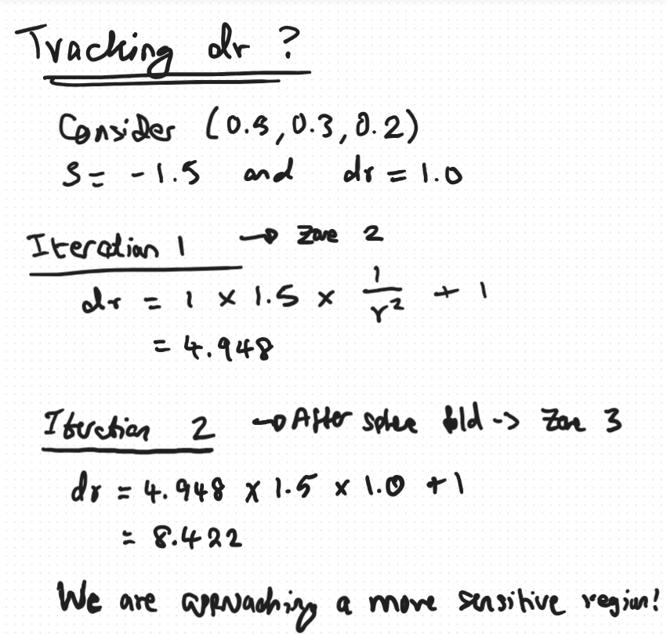

Slide 15
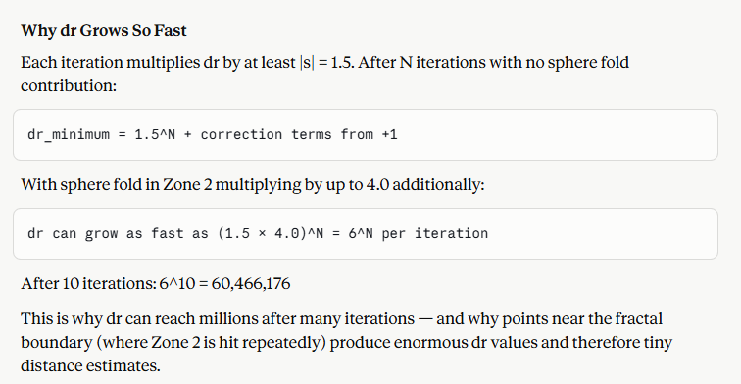

Slide 16
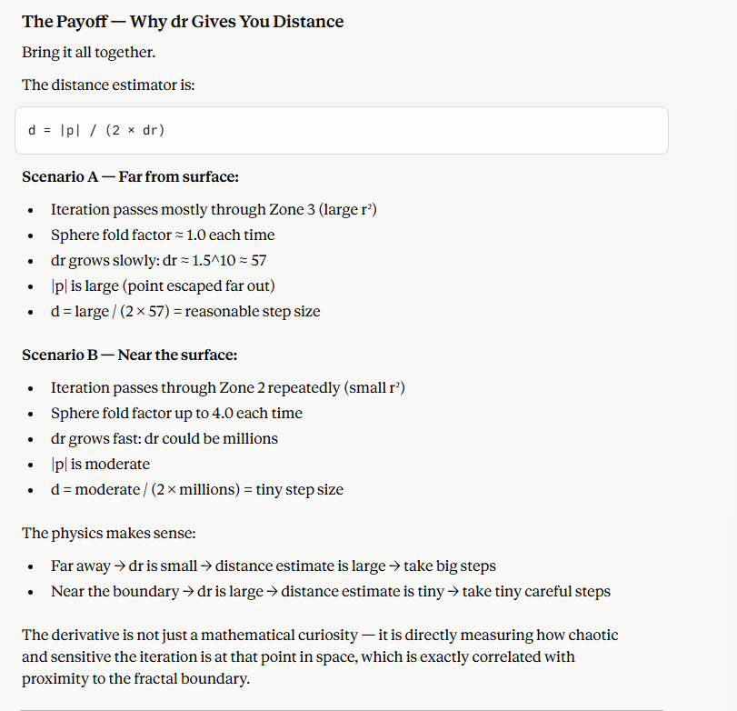

Slide 17
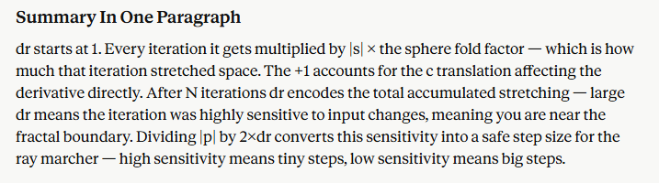

Slide 18
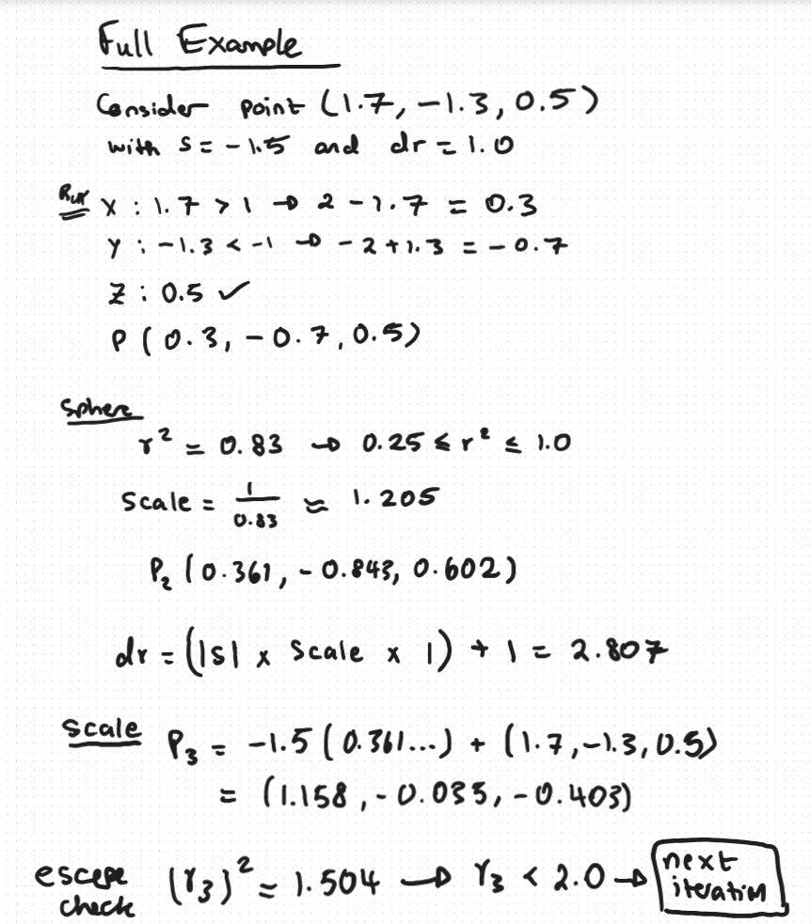
Escaping Points (The Outside/Exterior): Points whose values eventually explode toward infinity. These are colored based on how quickly they escaped (their escape velocity), resulting in colorful gradients.
Trapped Points (The Inside/Set): Points that do not diverge. Their coordinates fold and bounce around a confined space without ever leaving the boundary

Slide 19
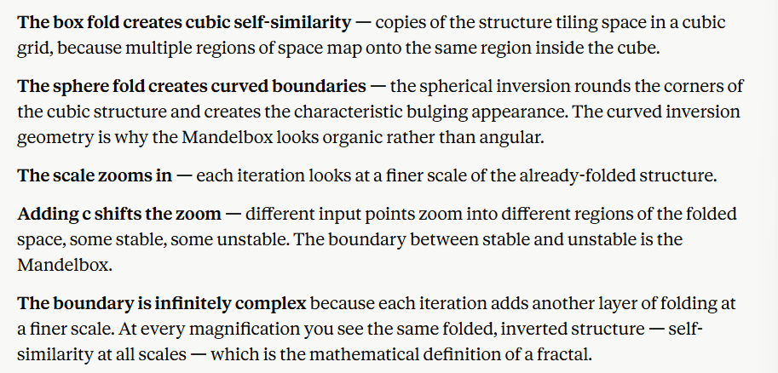

Slide 20
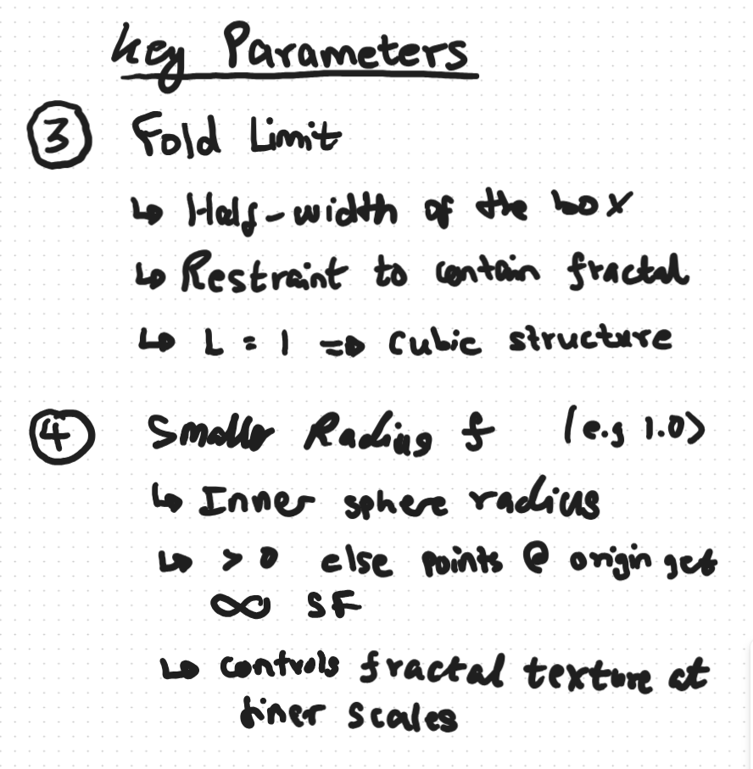
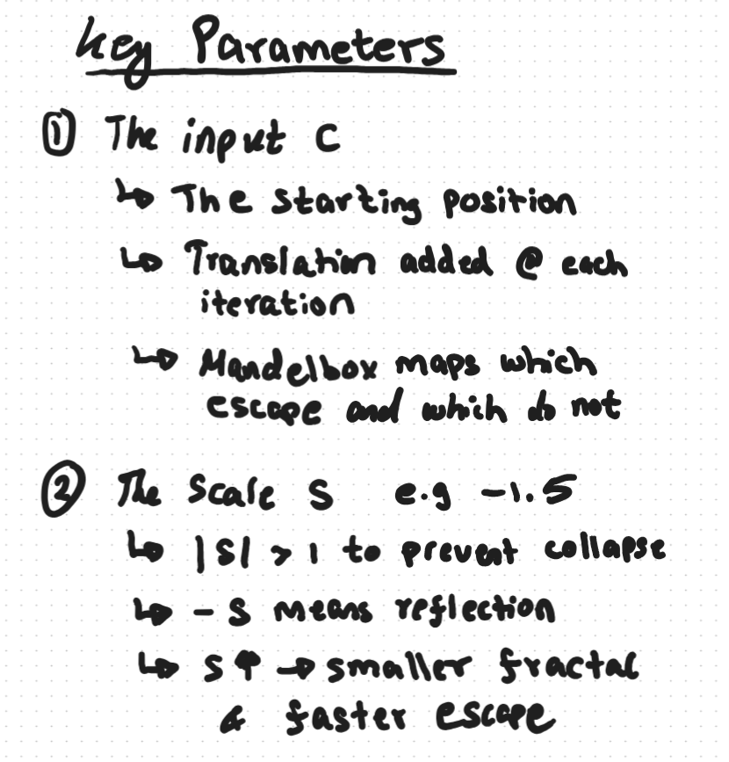


Slide 21
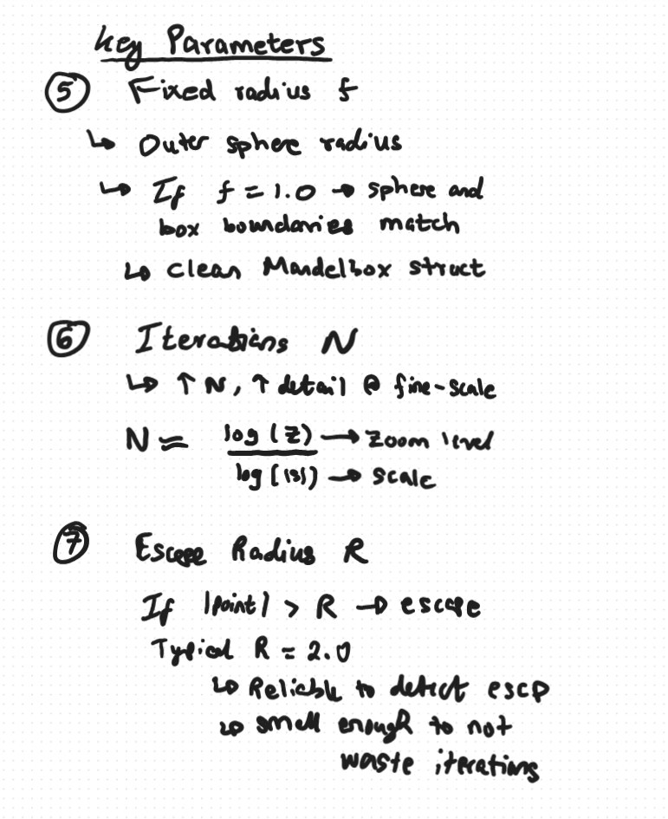

Slide 22
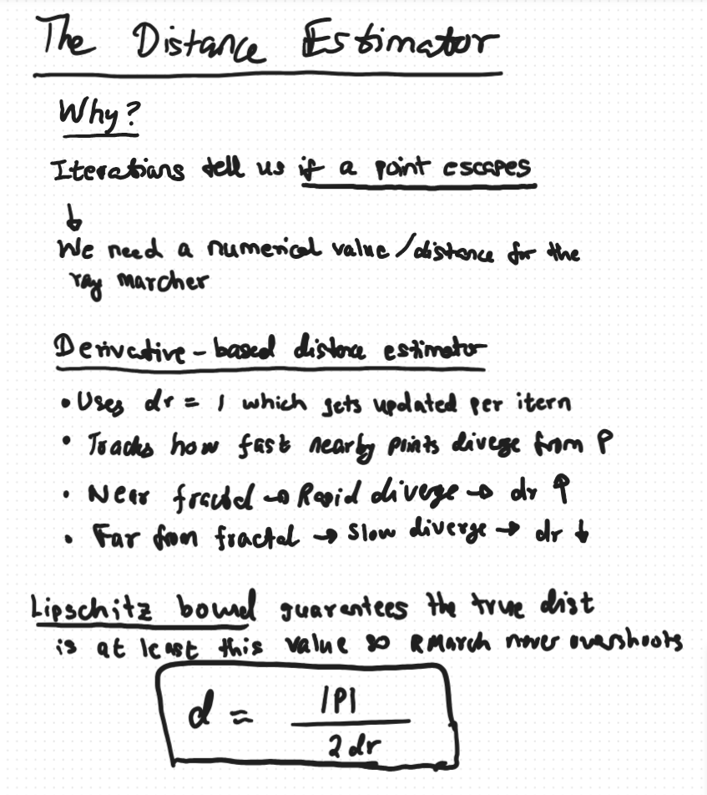

Slide 23
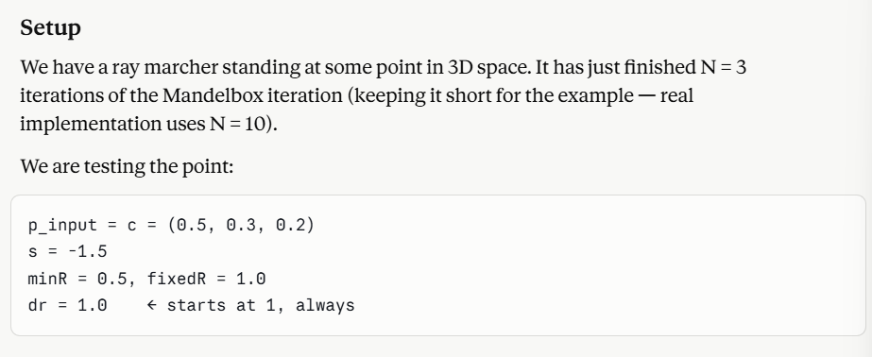
Worked Example

Slide 24
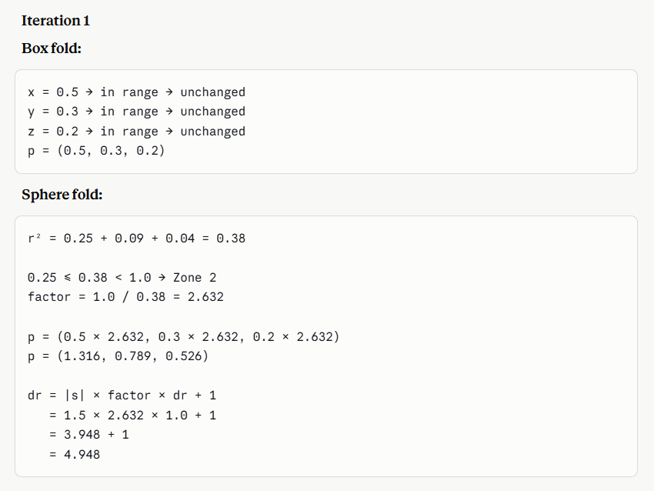
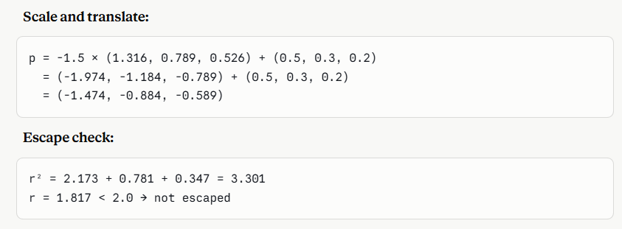

Slide 25
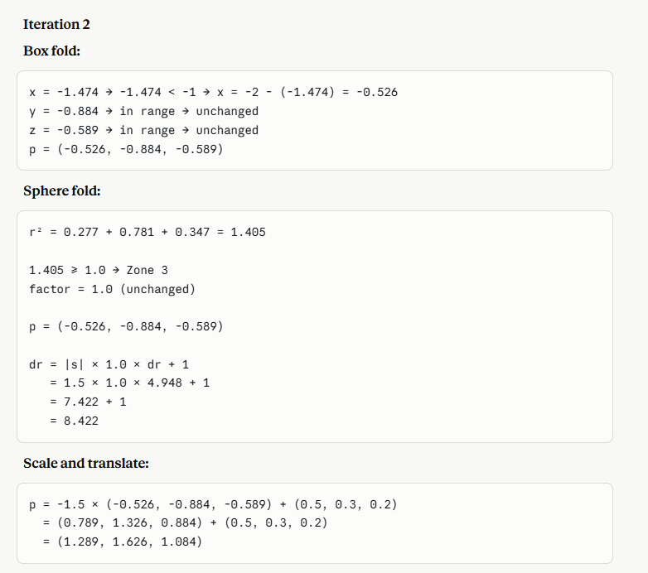
r² = 1.662 + 2.644 + 1.175 = 5.481
r = 2.341 > 2.0 → ESCAPED at iteration 2

Slide 26
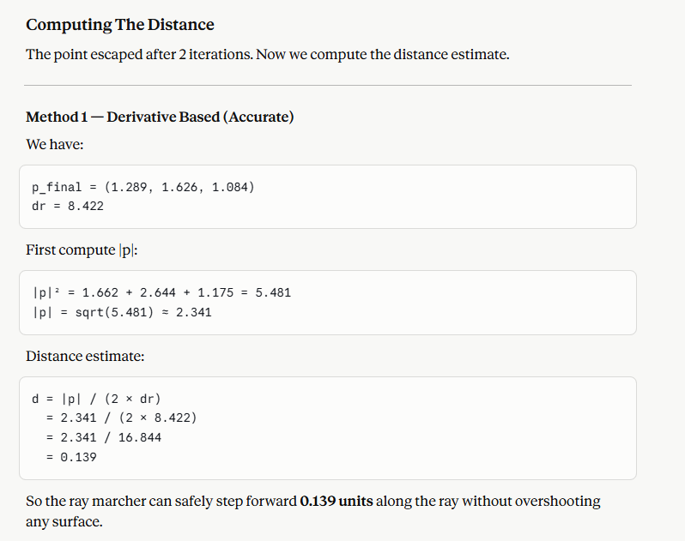

Slide 27
Why The Derivative Method Gives A Smaller (Safer) Distance
The derivative method accounts for the actual stretching that happened during iteration. In our example dr = 8.422 — space was stretched significantly. That means we are likely close to the fractal boundary — the large dr is a warning to be cautious — so the distance estimate comes out smaller and more conservative.
The constant method ignores this and just uses a fixed denominator. It is less sensitive to how chaotic the iteration was.

Slide 28
